Slide 1

AY-2025-2026
ODD SEM
Department of ECE
Analog electronic Circuit Design
23ec2104
Topic:
Small-Signal Operation and Models
Session - 07

Slide 2
Session content
Trans-conductance
Input Resistance at the Base
Input Resistance at the Emitter
Voltage Gain
Separating the Signal and the DC Quantities
Hybrid-π Model
T Model

Slide 3



AIM OF THE SESSION
To understand and analyze the small-signal behavior of Bipolar Junction Transistors (BJTs) using equivalent models for AC signal analysis.
INSTRUCTIONAL OBJECTIVES
The Session is designed to:
Define small-signal operation in BJTs and its purpose.
Explain the significance of small-signal models in amplifier analysis.
Describe the components of Hybrid-π and T-models.
LEARNING OUTCOMES
At the end of this session, learners will be able to:
Apply small-signal models for analyzing BJT amplifier circuits.
Derive and use small-signal parameters from DC operating points.
Choose the appropriate model (Hybrid-π or T-model) for different applications.

Slide 4
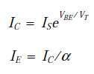
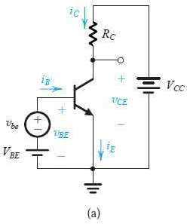
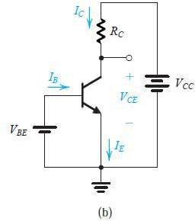

Small-Signal Operation and Models

Slide 5





Transconductance
vBE = VBE + vbe-----(1)
-----(2)
If vbe ˂ VT,
-----(3)

Slide 6


Transconductance
-----(3)
This approximation, which is valid only for vbe less than approximately 10 mV, is referred to as the small-signal approximation.
-----(4)
Thus the collector current is composed of the dc bias value
IC and a signal component ic ,

Slide 7


Transconductance
This equation relates the signal current in the collector to the corresponding base–
emitter signal voltage. It can be rewritten as

Slide 8
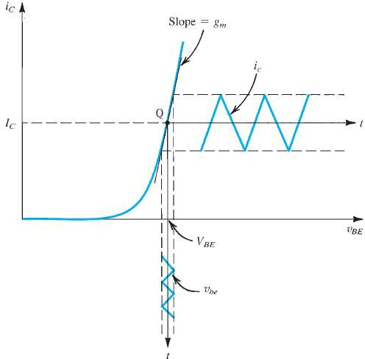

Transconductance

Slide 9






Input Resistance at the Base
The small-signal input resistance
between base and emitter, looking into the base, is denoted by rπ and is defined as
Thus,
where IB is equal Ic/β to and the signal component ib is given by
Substitute gm and Replace Ic/β by IB
Substituting for IC/VT by gm gives

Slide 10





Input Resistance at the Emitter
If we denote the small-signal
resistance between base and emitter looking into the emitter by re, it can be defined as
Thus,
where IE is equal to IC /α and the
signal current ie is given by

Slide 11
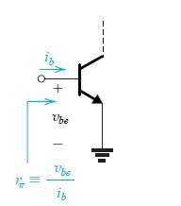

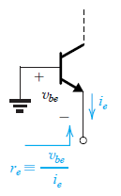
Input Resistance at the Emitter
The relationship between rπ and re can be found by combining their respective definitions
Thus,
which yields

Slide 12
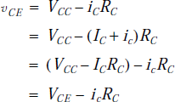


Voltage Gain
Thus the voltage gain of this amplifier Av is
Here the quantity VCE is the dc bias voltage at the collector, and the signal voltage is given by

Slide 13




Small Signal Operation
Transconductance
Input Resistance
at the Base
Input Resistance
at the Emitter
Voltage Gain

Slide 14
Separating the Signal and the DC Quantities
Every current and voltage in the amplifier circuit of Fig.(a) is composed of two components: a dc component and a signal component
For instance, vBE = VBE + vbe, iC = IC + ic, and so on

Slide 15
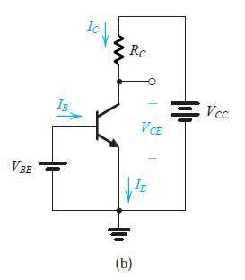


Separating the Signal and the DC Quantities
The dc components are determined from the dc circuit given in Fig. 6.36(b) and from the relationships imposed by the transistor.

Slide 16
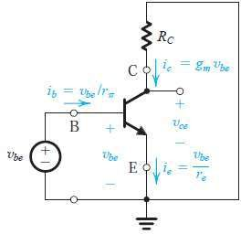
Separating the Signal and the DC Quantities
On the representation operation of
other hand, a of
the
the signal BJT can be
obtained by eliminating the dc sources, as shown in Fig.
Expressions for the current elements(ic, ib, and ie) obtained when a small signal vbe is applied.
Small-Signal Circuit Model.

Slide 17
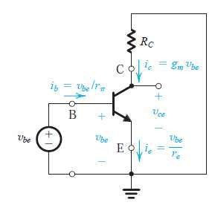
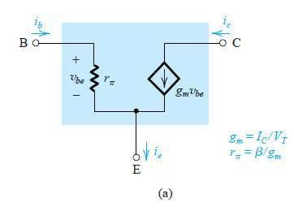
HYBRID π MODEL
This model represents the BJT as a voltage controlled current source
and explicitly includes the input resistance looking into the base , rπ

Slide 18

HYBRID π MODEL
In this model

Slide 19
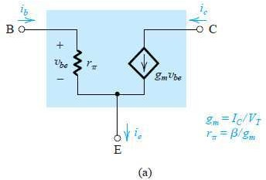
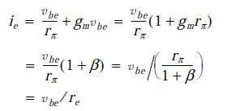

HYBRID π MODEL
In this model
Ie=ic+ib

Slide 20
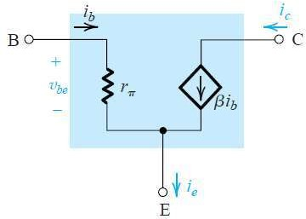

HYBRID π MODEL
Slightly different model can be obtained by expressing the current of the controlled source (gmvbe) interms of base current ib
Here the
transistor is
represented as a
controlled current
current- source,
Equivalent circuit model is
with the control current being
ib.

Slide 21
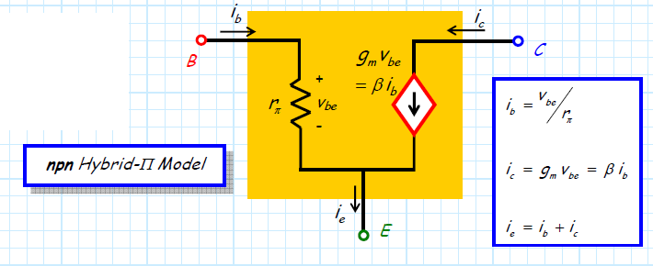
HYBRID π MODEL

Slide 22
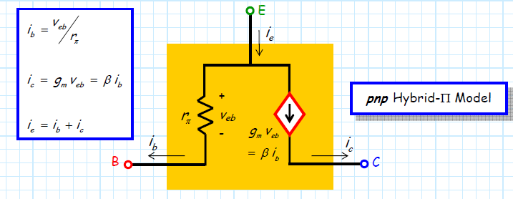
HYBRID π MODEL

Slide 23


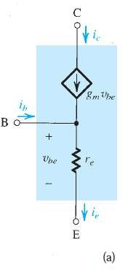



T Model
Ie=ic+ib
ib=ie-ic
The current of the controlled source can be expressed in terms of the emitter current.

Slide 24
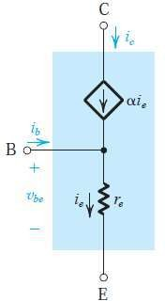
T Model
The current of the controlled source can be expressed in terms of the emitter current.

Slide 25

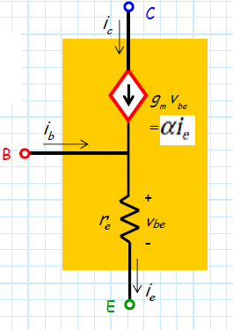
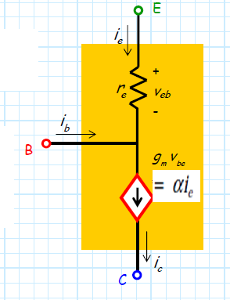
T Model

Slide 26


APPLICATION OF THE SMALL SIGNAL EQUIVALENT CIRCUIT
Eliminate the signal source and determine the dc operating point of the BJT and in particular the dc collector current IC.
Calculate the values of the small-signal model parameters:
3. Eliminate the dc sources by replacing each dc voltage source with a short circuit and each dc current source with an open circuit.

Slide 27
APPLICATION OF THE SMALL SIGNAL EQUIVALENT CIRCUIT
Replace the BJT with one of its small-signal equivalent circuit models. Although any one of the models can be used, one might be more convenient than the others for the particular circuit being analyzed.
  Hybrid-π Model
  T Model
  Hybrid Model
Analyze the resulting circuit to determine the required
quantities (e.g., voltage gain, input and output resistance).

